Slide 1
Optimization of Wavelets for Time Series Classification with Support Vector Machine
Team: Karnargus
William Argus & Karndeep Rai-Bhatti

Slide 2
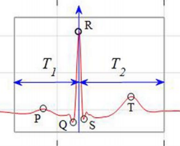
Problem Summary
Given a segment of time series data, quickly and accurately classify the data
Medical Data - ECG
Sensor Data - Gait
Environmental Data - Driving Surface
Classification of time series data
Manual analysis is inefficient, laborious, and error prone
Framed as a Pattern Detection problem
Small training set

Slide 3
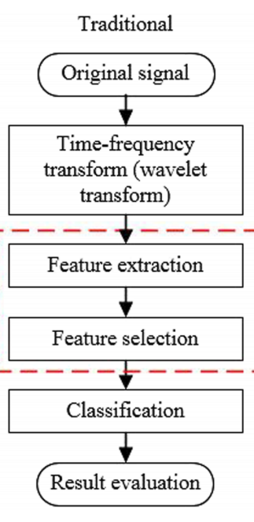
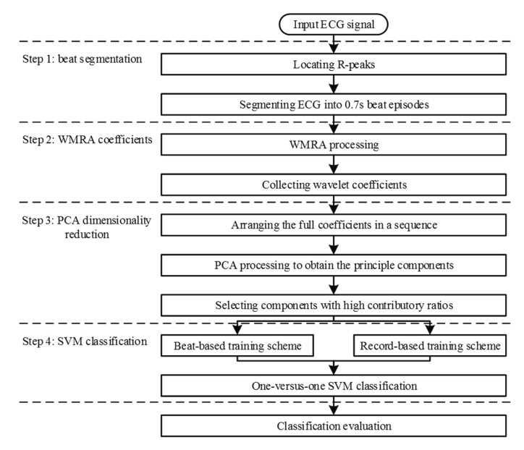
Other Approaches: Pro and Con
Acharya et al.
Bior Wavelet Transform > sub-band fuzzy entropy & log-energy > Binary SVM classification
Min et al.
PCA, LDA, ICA > classification with NN, SVM classifiers, PNN
Liu et al.
bior(6,8) Wavelet Transform > PCA > SVM
Melgani et al.
Wavelet optimization: wavelet > SVM
Pro: Consistently Get high accuracy ~ 99%
Common Problem: Classification schemes optimized/trained across whole database
Underperform in realistic setting where only prior data is available

Slide 4

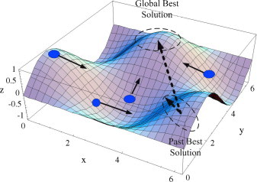
Proposed Approach
Initialize θ & velocity values for each particle
Baseline - Classification Scheme Proposed by Liu et al.
Beat Segmentation
8-level WMRA using bior(6,8) wavelets
12 component PCA transform for SVM transform
Optimize Wavelet using Particle Swarm Optimization (PSO)
Search over Orthonormal Wavelets
Construct Wavelet (Sherlock-Monro algorithm)
Update θs & velocity based on
local and global min error
8-level WMRA
PCA: Dimension reduction
An Example of particles motion across the space defined by particle’s location and the current error
Train SVM, Calculate Error

Slide 5
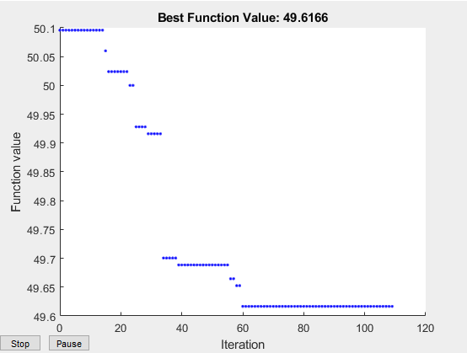
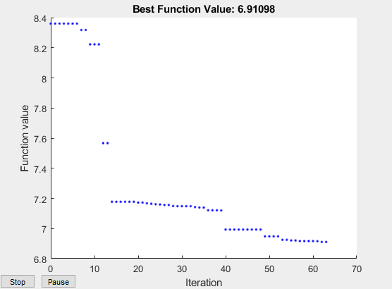
Results of Particle Swarm Optimization
Record Based Training
PSO used to find 2 different wavelets
SVM is trained under record based scheme (independent patients train vs test)
SVM is trained under beat based scheme (same patient)
40 particles
Trained on 500 samples, tested on 10,000
Beat Based Training

Slide 6
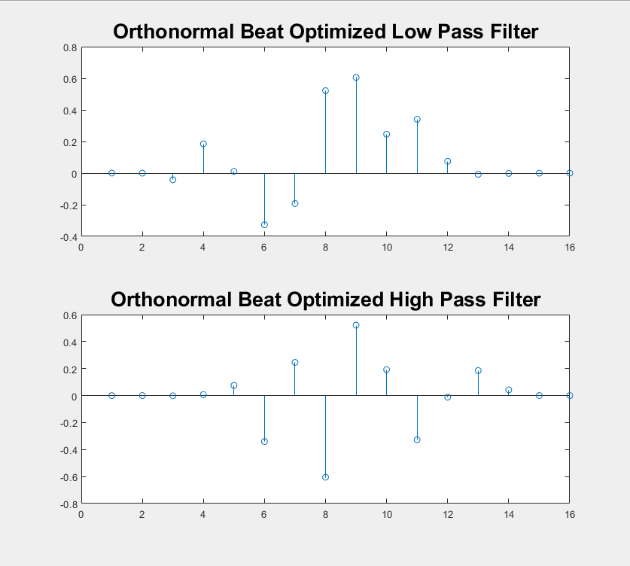
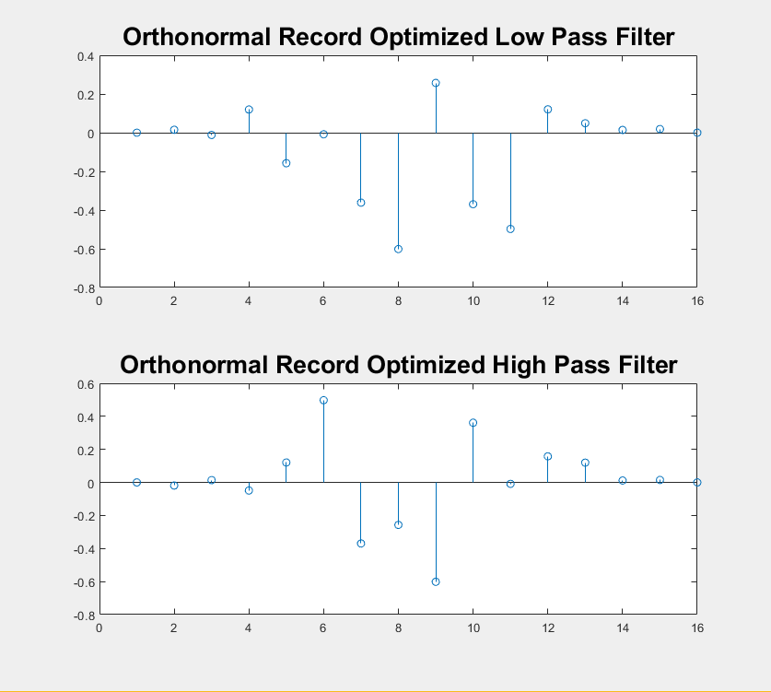
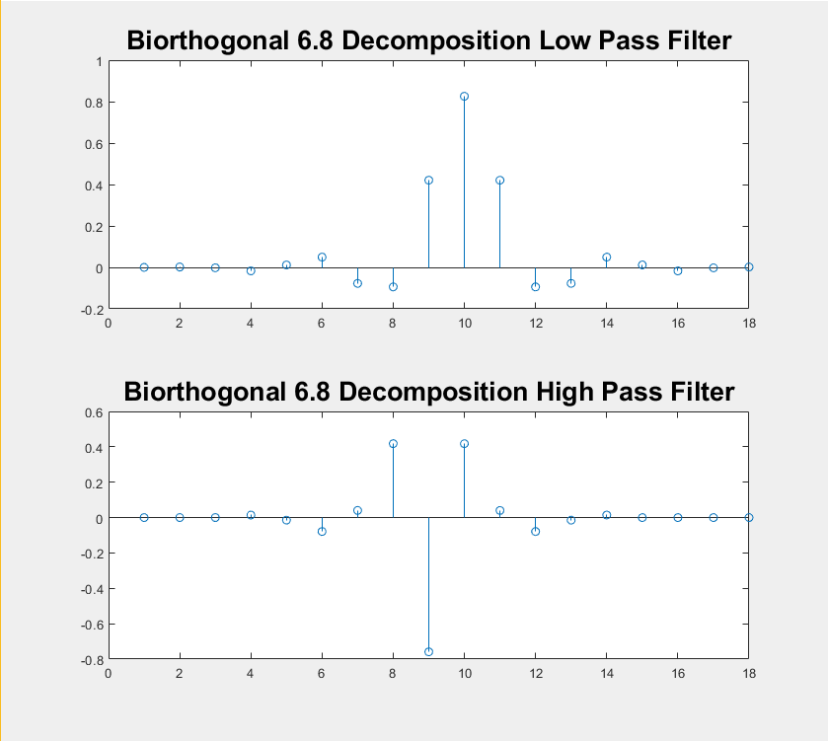
Optimized Wavelets and Bior(6,8) Structures
The structure of the final beat optimized and record optimized wavelet compared to Bior(6,8)
Resulting wavelets shown are after convergence of PSO

Slide 7
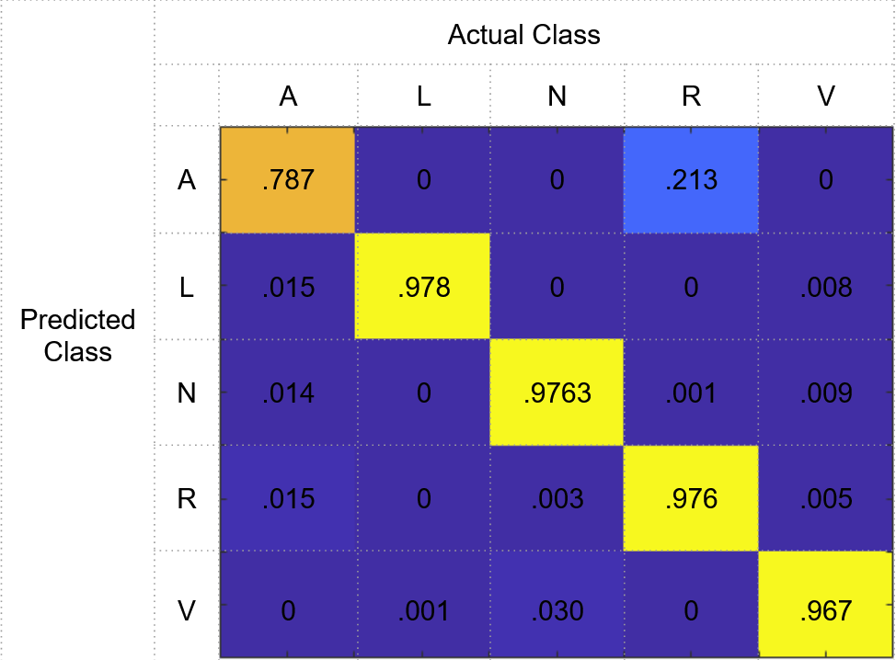
Optimized Wavelets Applied to the Stated Problem
Train/Test split | Bior(6,8) | Record based Optimization | Beat based Optimization
Random 20/80 | 96.2% | 98.79% | 98.46%
300 beats/ remainder | 97.30% (4%) | 97.54% (3.85%) | 97.80% (3.69%)
60 beats/ remainder | 94.35% (7.97%) | 94.58% (7.86%) | 94.05% (9.04%)
Example Confusion Matrix, from Record based optimized wavelet, 300 beats
Tested using 10 fold cross validation

Slide 8
Summary
Problem to be solved
Design an approach to classify ECG signals
Show it performs well in realistic scenarios
Proposed approach
Use wavelet decomposition and PCA, classify with SVM
Optimized out own Wavelet using Particle Swarm Optimization
Results
2 Optimized Wavelets compared favorably with Bior(6,8)
Conclusion
Optimized wavelets performed comparably to Bior(6,8)
Improvement may be possible with more computational resources

Slide 9
Works Cited
[1] Acharyabcd, U.Rajendra. “A New Method to Identify Coronary Artery Disease with ECG Signals and Time-Frequency Concentrated Antisymmetric Biorthogonal Wavelet Filter Bank.” Pattern Recognition Letters, vol. 125, 1 July 2019, pp. 235–240.
[2] Daamouche, Abdelhamid & Hamami, Latifa & Alajlan, Naif & Melgani, Farid. (2012). A wavelet optimization approach for ECG signal classification. Biomedical Signal Processing and Control - BIOMED SIGNAL PROCESS CONTROL. 7. 10.1016/j.bspc.2011.07.001.
[3] Fatin, A. E. et al. Arrhythmia recognition and classification using combined linear and nonlinear features of ECG signals. Comput. Methods Programs Biomed. 127, 52–63 (2016).
[4] Martis, R. J., Acharya, U. R. & Min, L. C. ECG beat classification using PCA, LDA, ICA and discrete wavelet transform. Biomedical Signal Processing and Control 8, 437–448 (2013).
[5] Martis, R. J. et al. Characterization of ECG beats from cardiac arrhythmia using discrete cosine transform in PCA framework. Knowledge-based Systems 45, 76–82 (2013).
[6] Qin, Q., Li, J., Zhang, L. et al. Combining Low-dimensional Wavelet Features and Support Vector Machine for Arrhythmia Beat Classification. Sci Rep 7, 6067 (2017). https://doi.org/10.1038/s41598-017-06596-z
[7] Sherlock, B., & Kakad, Y.P. (2002). MATLAB Programs for Generating Orthonormal Wavelets.

Slide 10
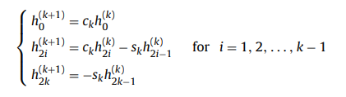
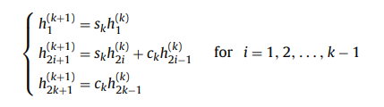
Appendix
Sherlock and Monro recursive formula for orthonormal wavelets

